Slide 2
Midterm Presentation: Routing in a Photonics circuits
RESEARCH GROUP HARDWARE AND EMBEDDED SYSTEMS(HES), Photonics Research Group(PRG), ID Lab
Xiaoke Wang Promoter: Dirk Stroobandt, Wim Bogaerts Supervisor: Ferre Vanden Kerchove

Slide 3
1. Background

Slide 4
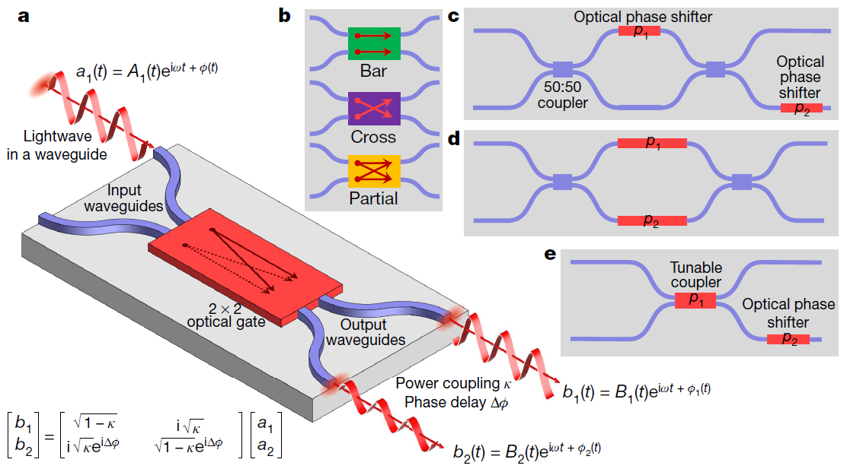
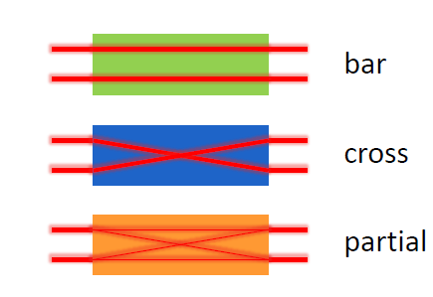
Universal 2x2 optical gates

Slide 5
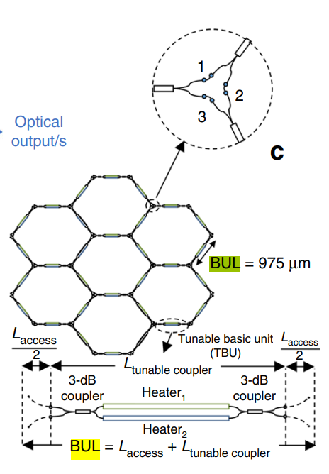
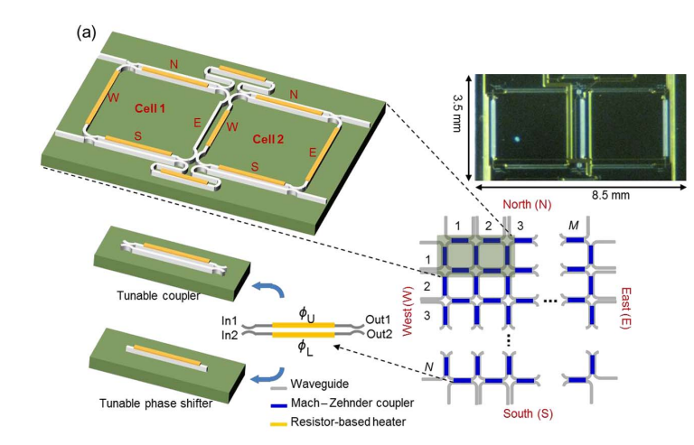
Recirculating mesh
Square Mesh¹
Hexagonal Mesh²

Slide 6
Programmable Photonics
Three graph structure to express the hexagonal FPPGA
e. Undirected graph
f. Undirected graph with 4 extra nodes with negative weights
g. Directed graph with 8 nodes to describe one coupler

Slide 7
2. Routing

Slide 8
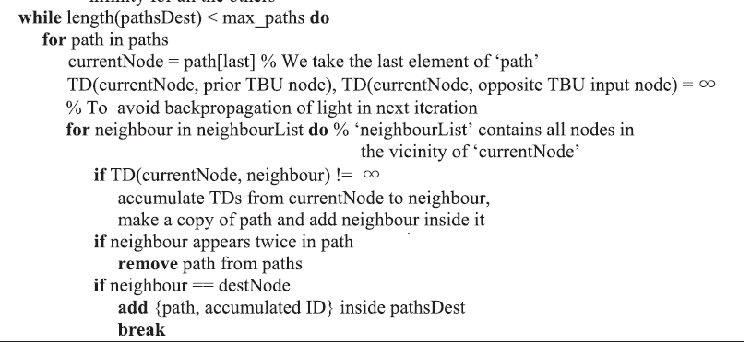
Auto routing
Sequential routing model
A Straightforward method to route source sink pairs
$$\text{TDxy}= c1・IL +c2・BUL +c3・PC$$
Pseudo Code:
IL: Insertion Loss
BUL: Basic Unit Length
PC: Power Consumption

Slide 9
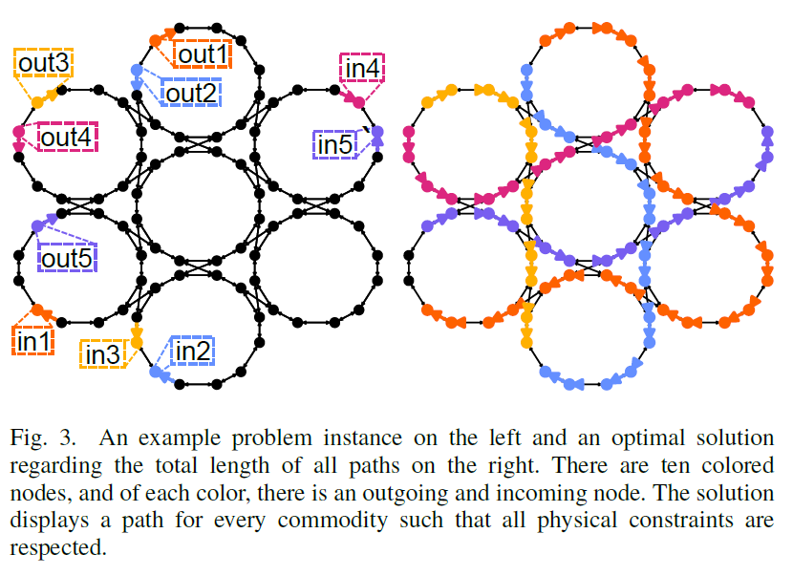
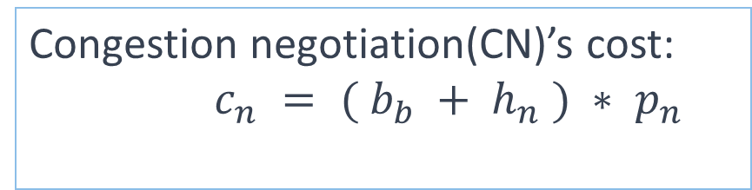
Source-sink pair routing
AURORA (Automated Router with Optical Resource Adaptation)
Example problem(left) and optimal solution(right)
$$b(a) = c1・IL +c2・BUL +c3・PC$$
$$w(a) = (b_{a} + h_{a} ・ HI) ・ (p_{a} + 1)$$
Congestion negotiation(CN)’s cost:
$c_{n} = ( b_{b} + h_{n} ) ∗ p_{n}$
Mostly tested radius equal to 8, $1+3r(r+1)=217$ hexagons

Slide 10
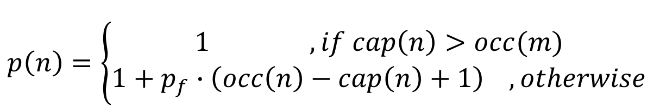
FPGA routing (VTR)
VTR: Verilog-to-Routing project
VPR Breadth-First router, based on the pathfinder
VPR Directed Search Routing Algorithm
$$f (n) =c_{prev} \text{+ }\text{b}\text{(}\text{n}\text{) }\text{· }\text{h}\text{(}\text{n}\text{) }\text{· }\text{p}\text{(}\text{n}\text{) + }\text{α}\text{ ·}{ c}_{exp}$$
Congestion penalty:
$$p\left(n\right)=\left\{\begin{aligned}1 , if cap\left(n\right)>occ(m) \\ 1+p_{f}∙\left(occ\left(n\right)−cap\left(n\right)+1\right) , otherwise\end{aligned}\right.$$
Expect Cost(Manhattan distance):
$$c_{exp}(n)=n_{\text{ortho}}\text{ · }b_{\text{ortho}}+n_{same dir}∙b_{same dir}+b_{ipin}+b_{sink}$$

Slide 11
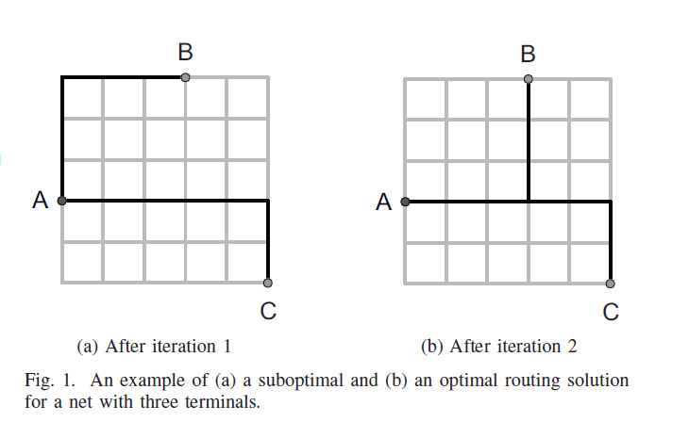
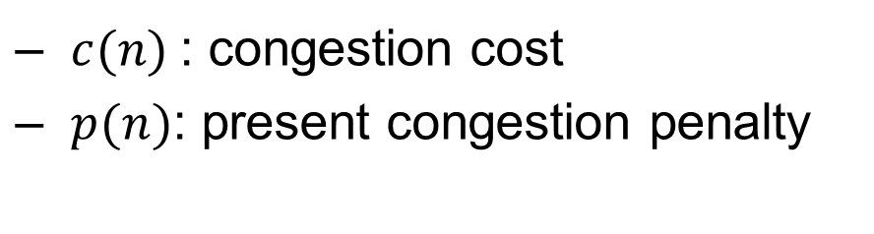
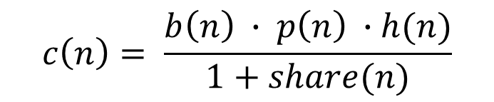
Connection-based-router
Wirelength-driven-routing
Negotiated Sharing Mechanism: share(n)
$$f(n) = c_{prev} (n) + c(n) + α · c_{exp} (n)$$
$$c\left(n\right)= \frac{b\left(n\right) ∙ p\left(n\right) ∙h(n)}{1+share(n)}$$
$c(n)$: congestion cost
$p(n)$: present congestion penalty
An example of a suboptimal(a) and an optimal(b) routing solution for a net
with three terminals

Slide 12
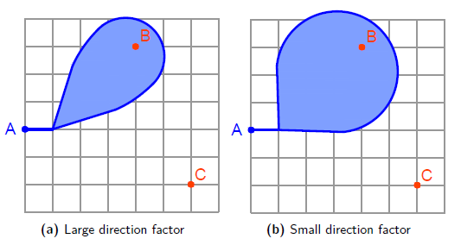
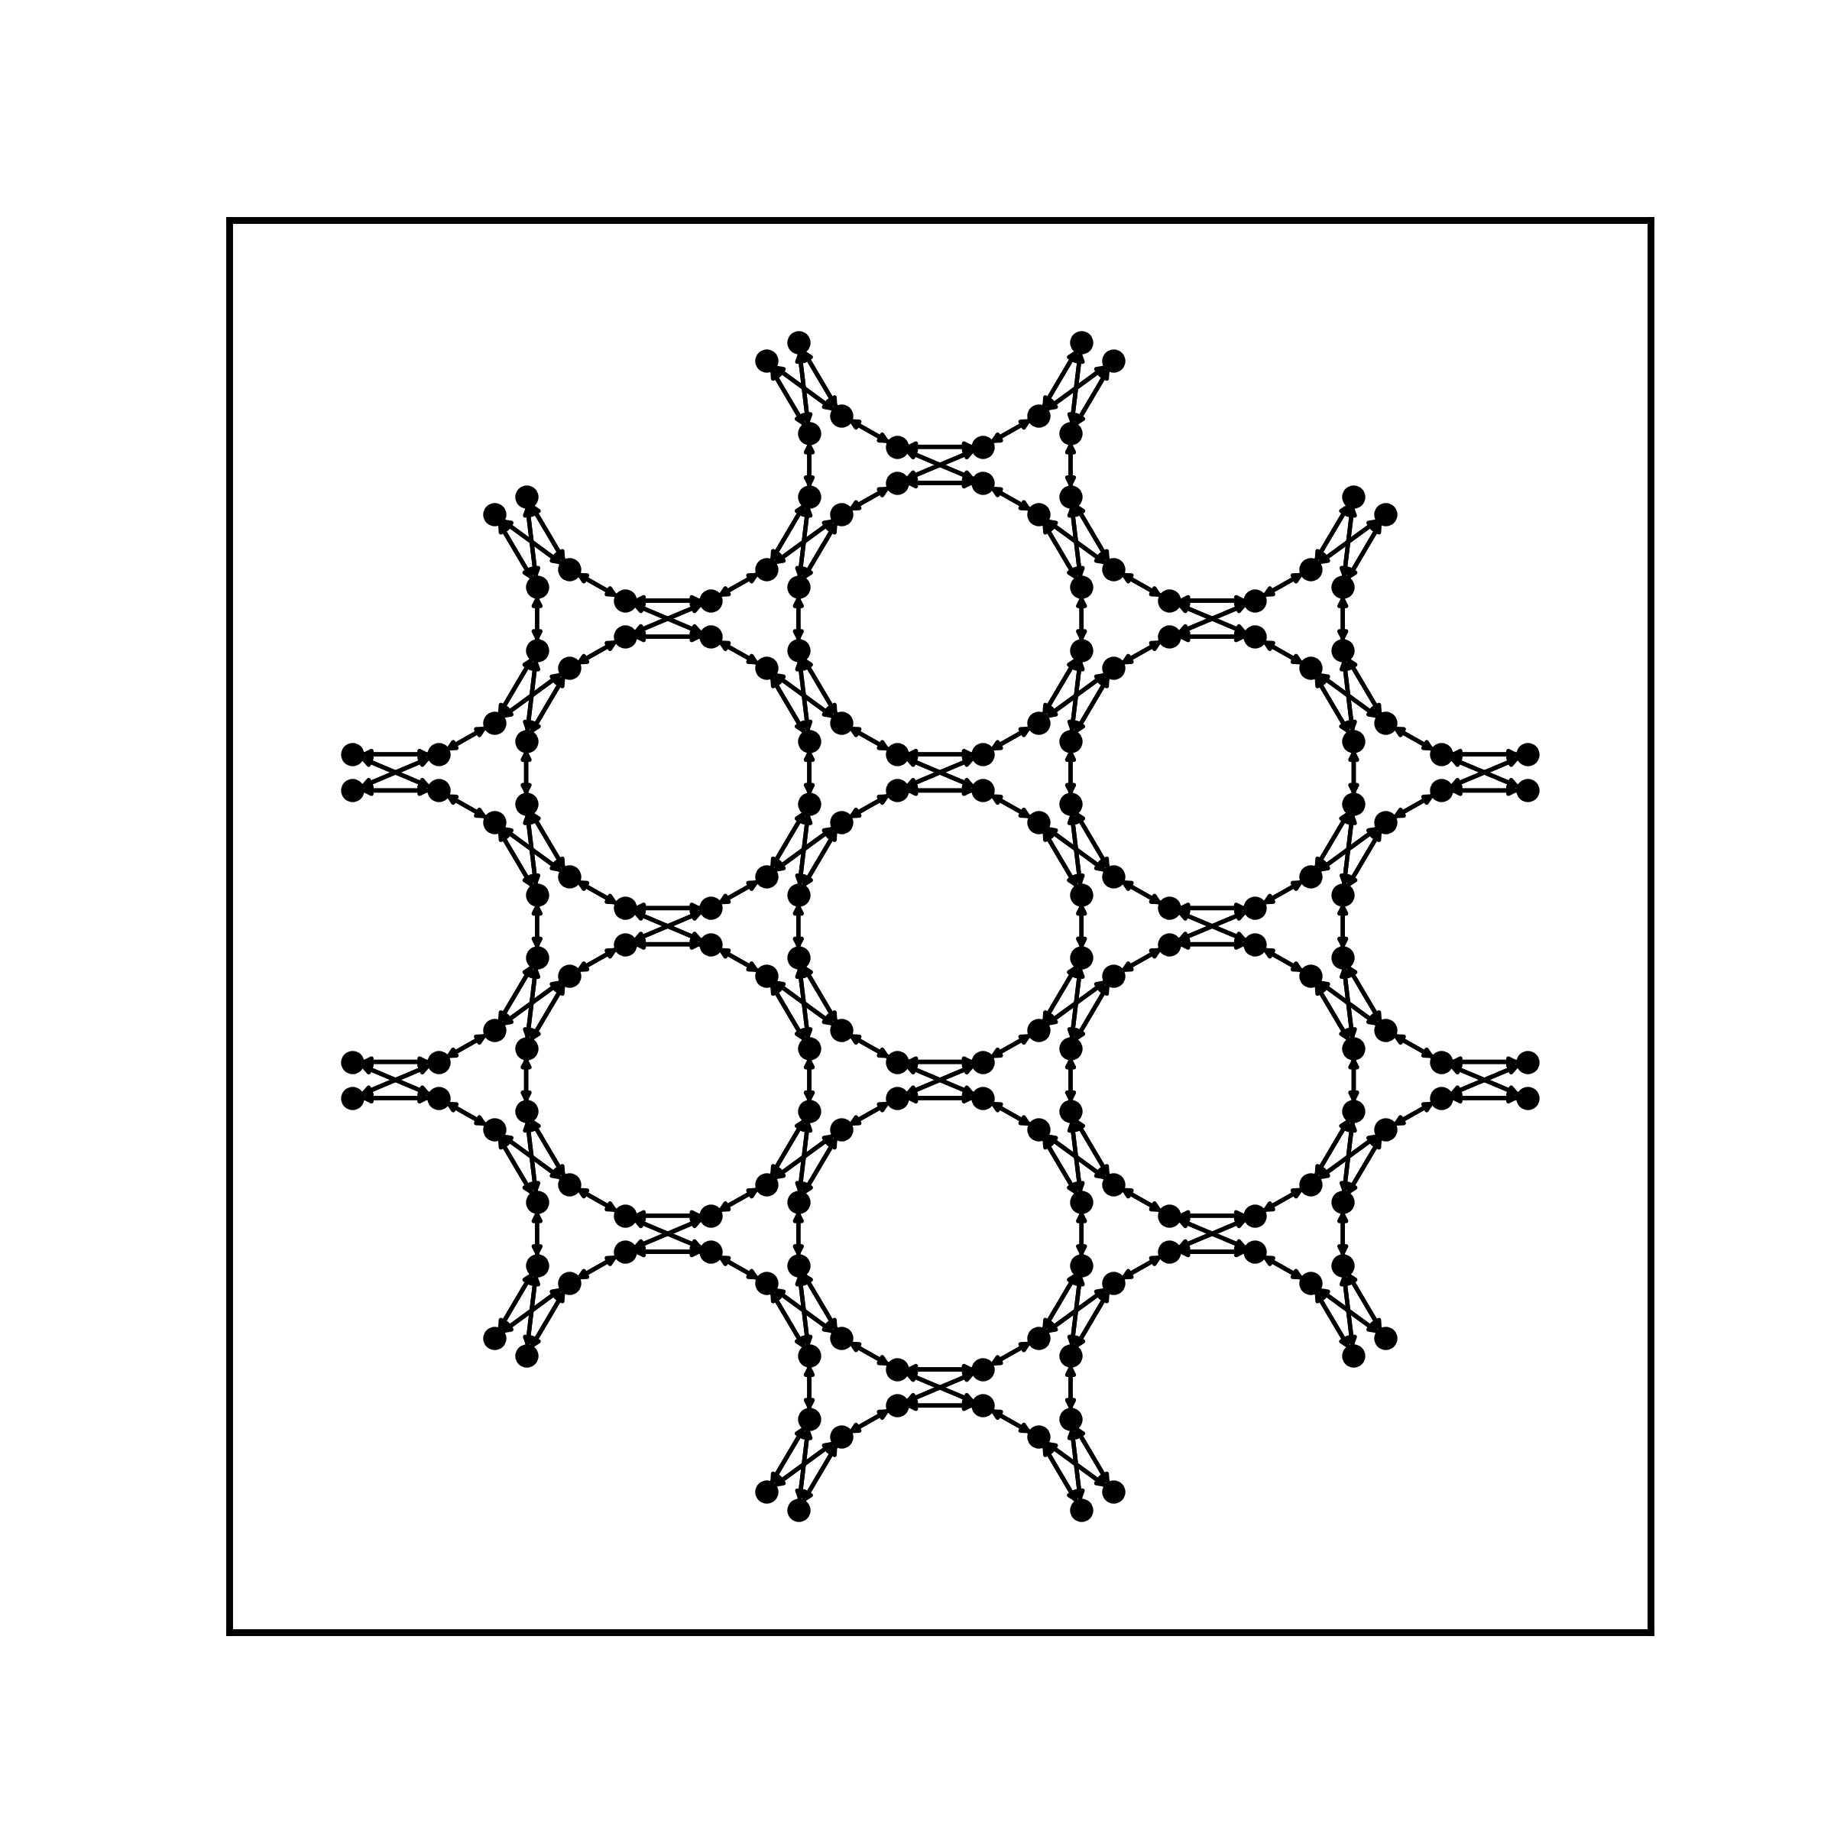
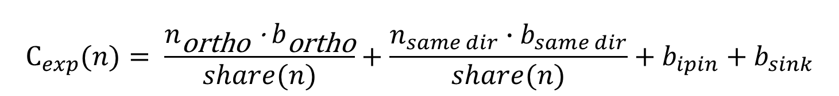
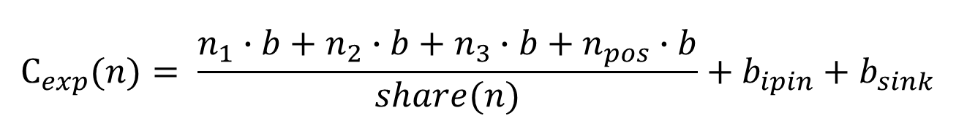
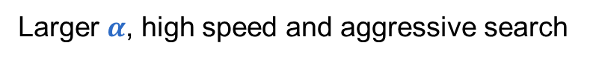
Expected Cost
In FPGA:
$$C_{exp}(n)= \frac{n_{\text{o}\text{rtho}}\text{ · }b_{\text{o}\text{rtho}}}{share(n)}+\frac{n_{same dir}∙b_{same dir}}{share(n)}+b_{ipin}+b_{sink}$$
Larger $α$, high speed and aggressive search
$×α$ : direction factor
02-2
axis2
-12-1
11-2
In FPPGA:
01-1
-220
20-2
$$C_{exp}(n)= \frac{n_{1}∙b+n_{2}∙b+n_{3}∙b+n_{pos}∙b}{share(n)}+b_{ipin}+b_{sink}$$
-110
000
-211
000
axis1
2-1-1
-101
1-10
$$dist= \left|x_{1}−x_{2}\right|+\left|y_{1}−y_{2}\right|+ \left|z_{1}−z_{2}\right|+{min(\left|{pos}_{1}−{pos}_{2}\right|)}_{clk,c−clk}$$
-202
0-11
2-20
-1-12
1-21
axis3
0-22

Slide 13
3. Example results

Slide 14
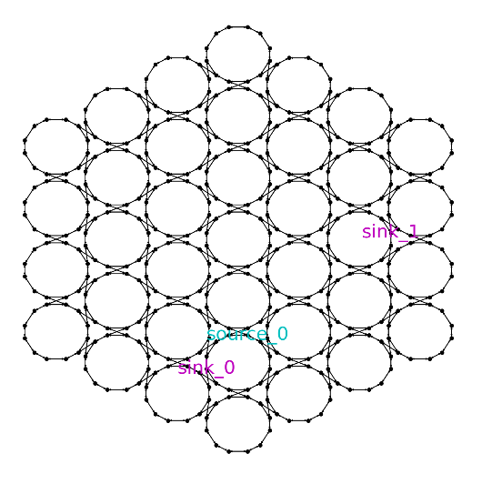
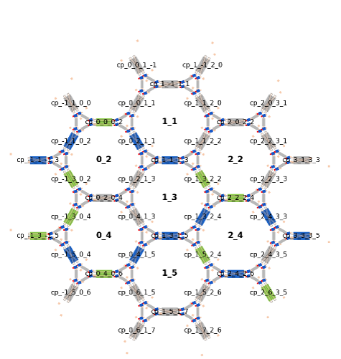
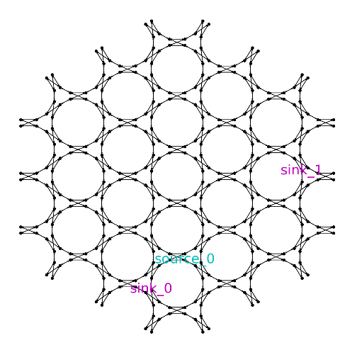
Modifications of the model
A modification with ports at the outer layer( for lasers, light-detectors or external devices )
Same as Borna framework for hexagonal mesh*
r = 2
r = 2

Slide 15
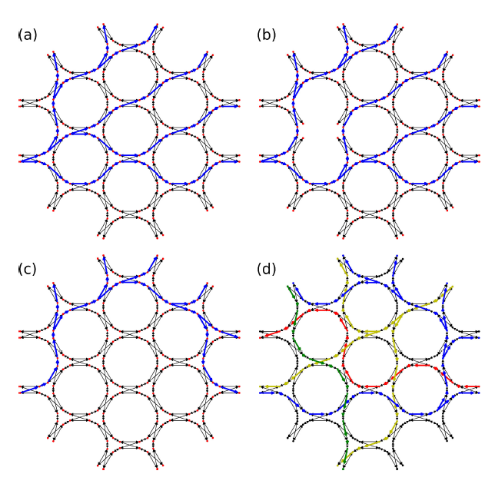
Multi-sinks-routing
Form an Integer Programming to solve
This directed Steiner Tree problem.
（binary decision variable associate with edge）
(a) edge costs are proportional to the flowpassing through the edge
(c) edge cost count only once for any flows using that edge

Slide 16
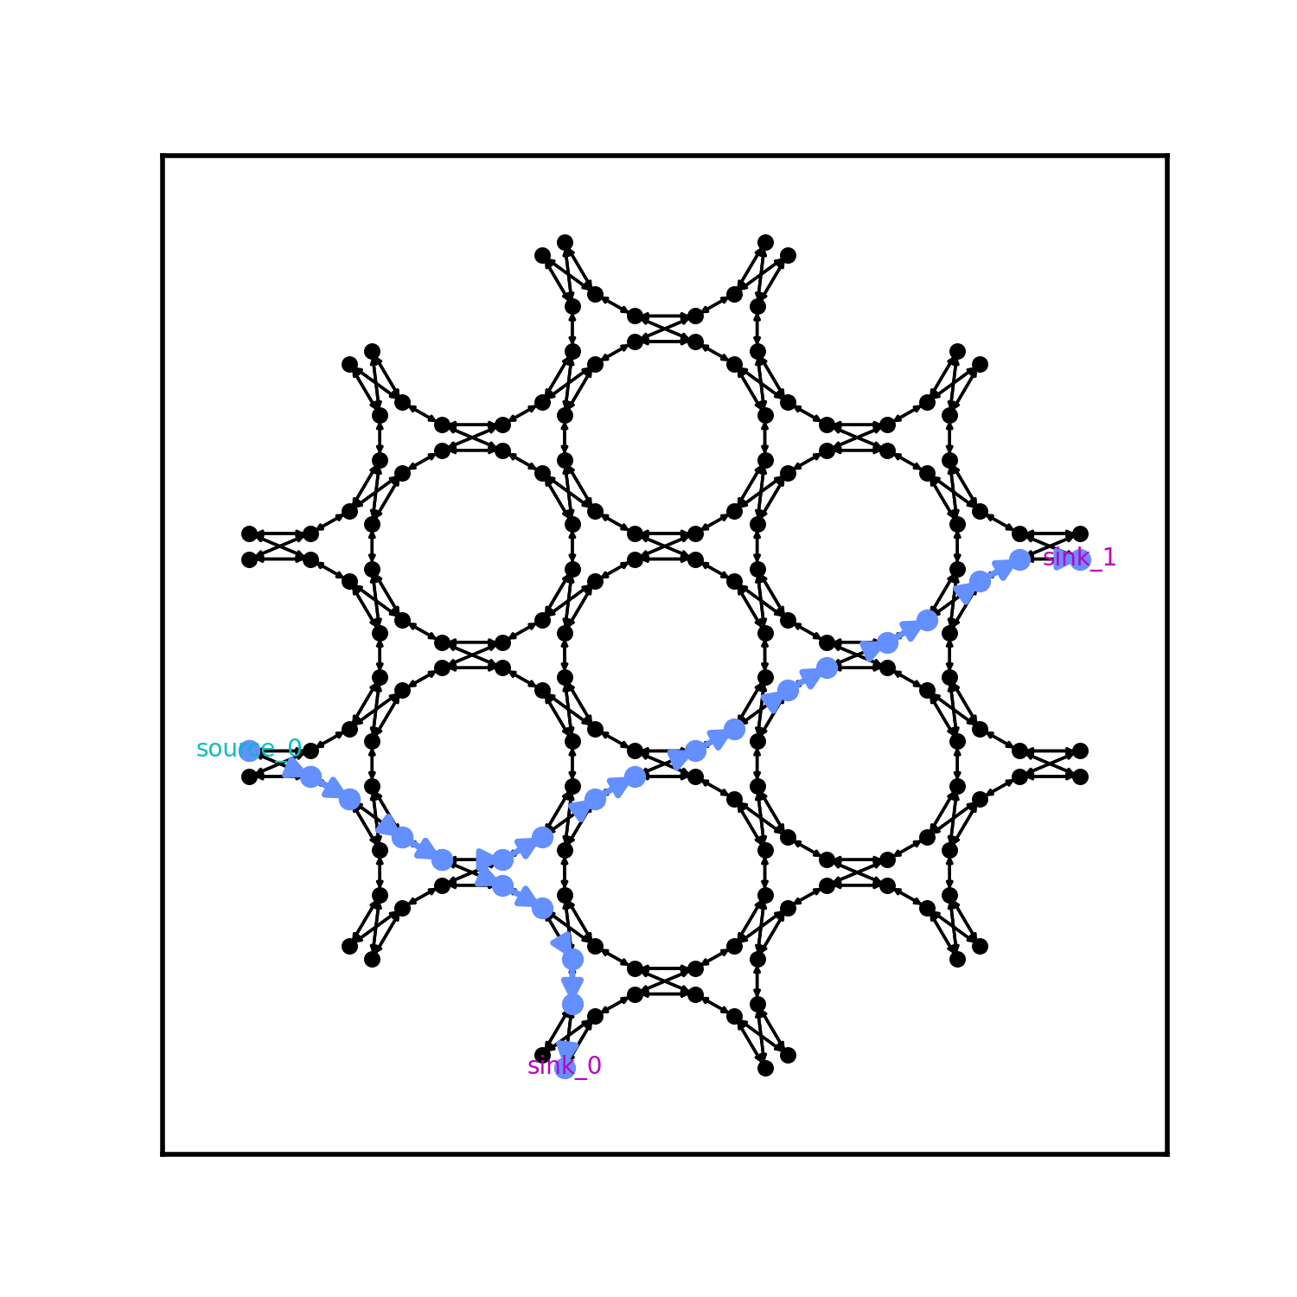
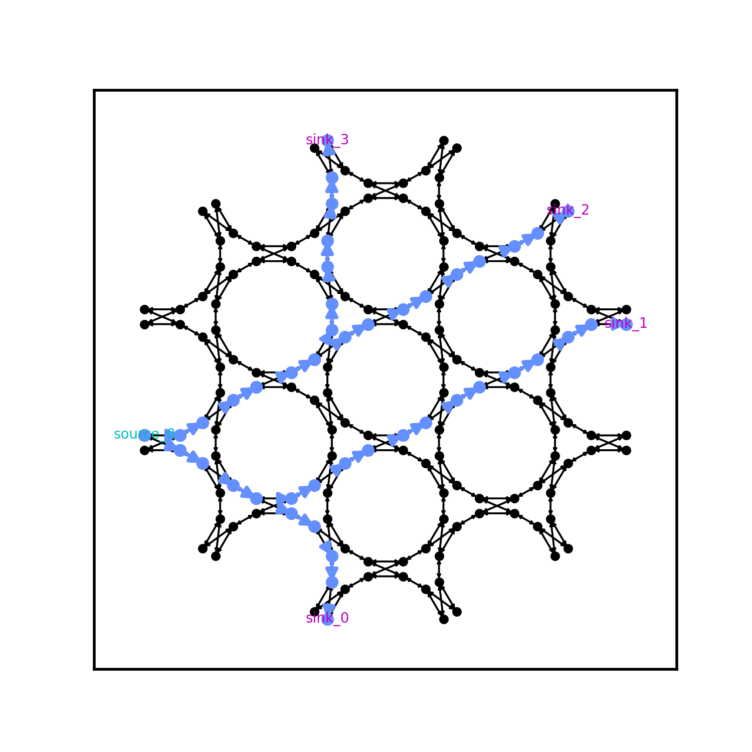
Some Results
Pathfinder routings in radius 1 mesh:
1 source 2 sinks problem
1 source 4 sinks problem

Slide 17
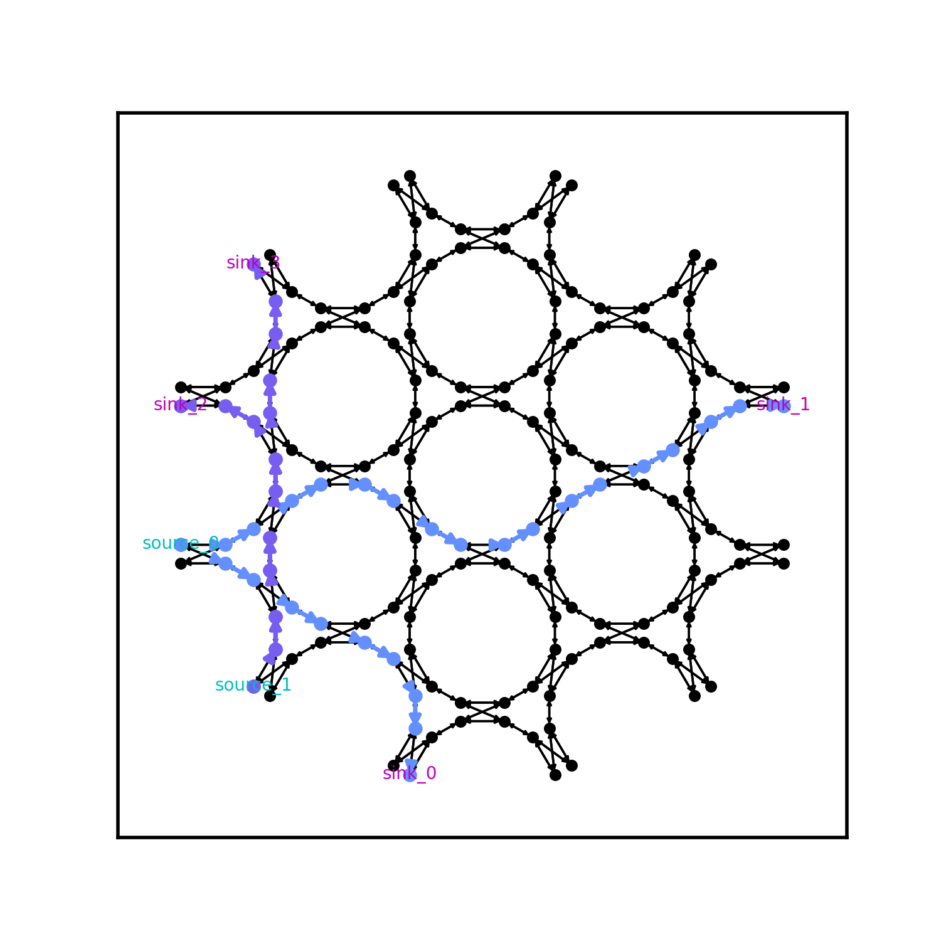
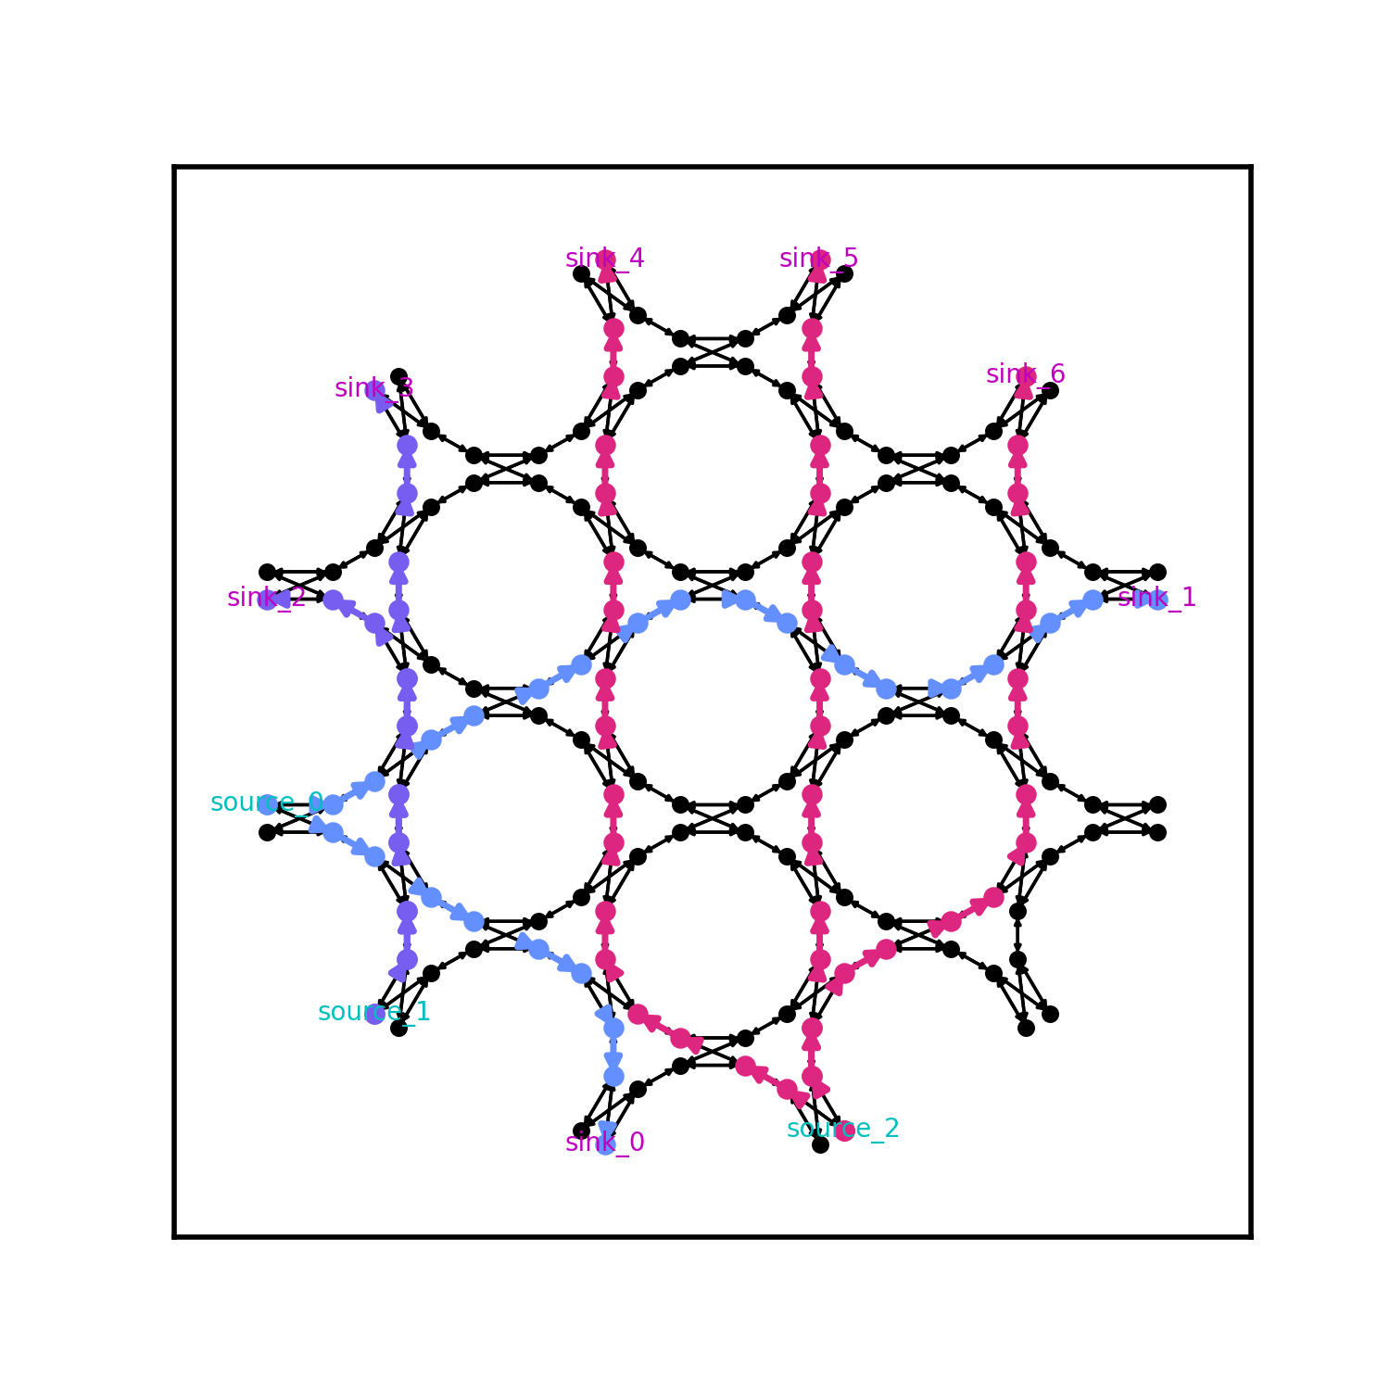
Some RESULTS
Two 2 sinks nets and one 3 sinks net
Two 2 sinks nets

Slide 18
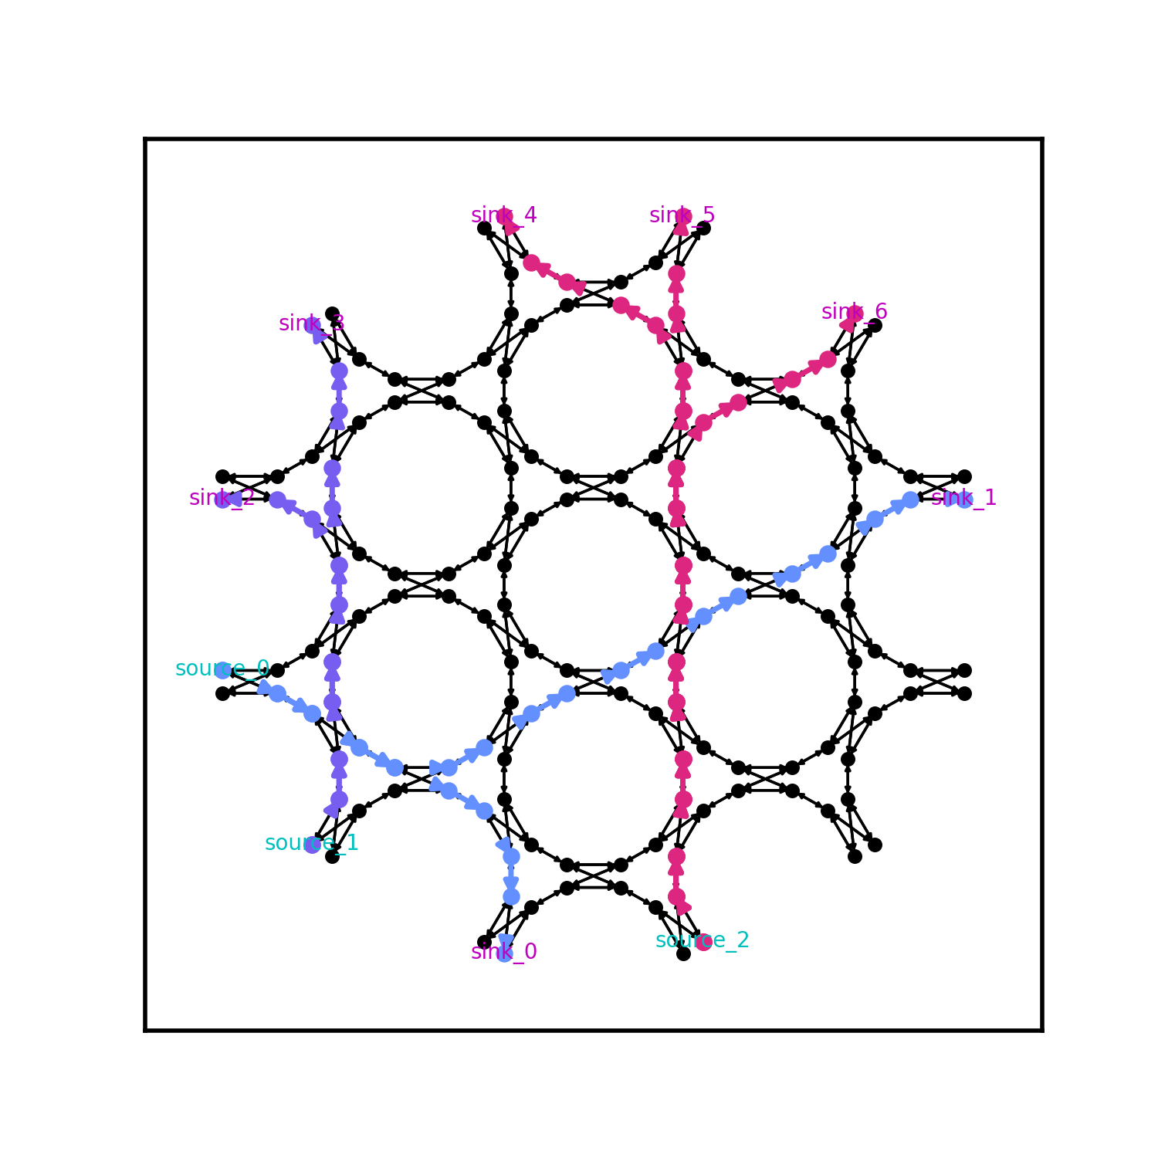


Results comparison
Before & After adding share sinks value as denominator of cost function to achieve Connection Based Router
Pathfinder
Connection Based Router

Slide 19
Multi-sinks Problem Generator
Used an embedded list to express multiple sinks in code
Can randomly generate controlled amount of nets(multi-sinks) problems

Slide 20
4. Plan & unsolved issues

Slide 21
Second term plan
Finish the Croute
directed search with expect cost, also issues on historical congestion penalty
Do the test on the larger scale test set (max radius 8)
Tune the parameters of history increase and violations, iterations
Analyze the time cost, unsolved percentage and parameters influence
Control the path wire length? And fan-in about realistic antenna array problem?

Slide 22
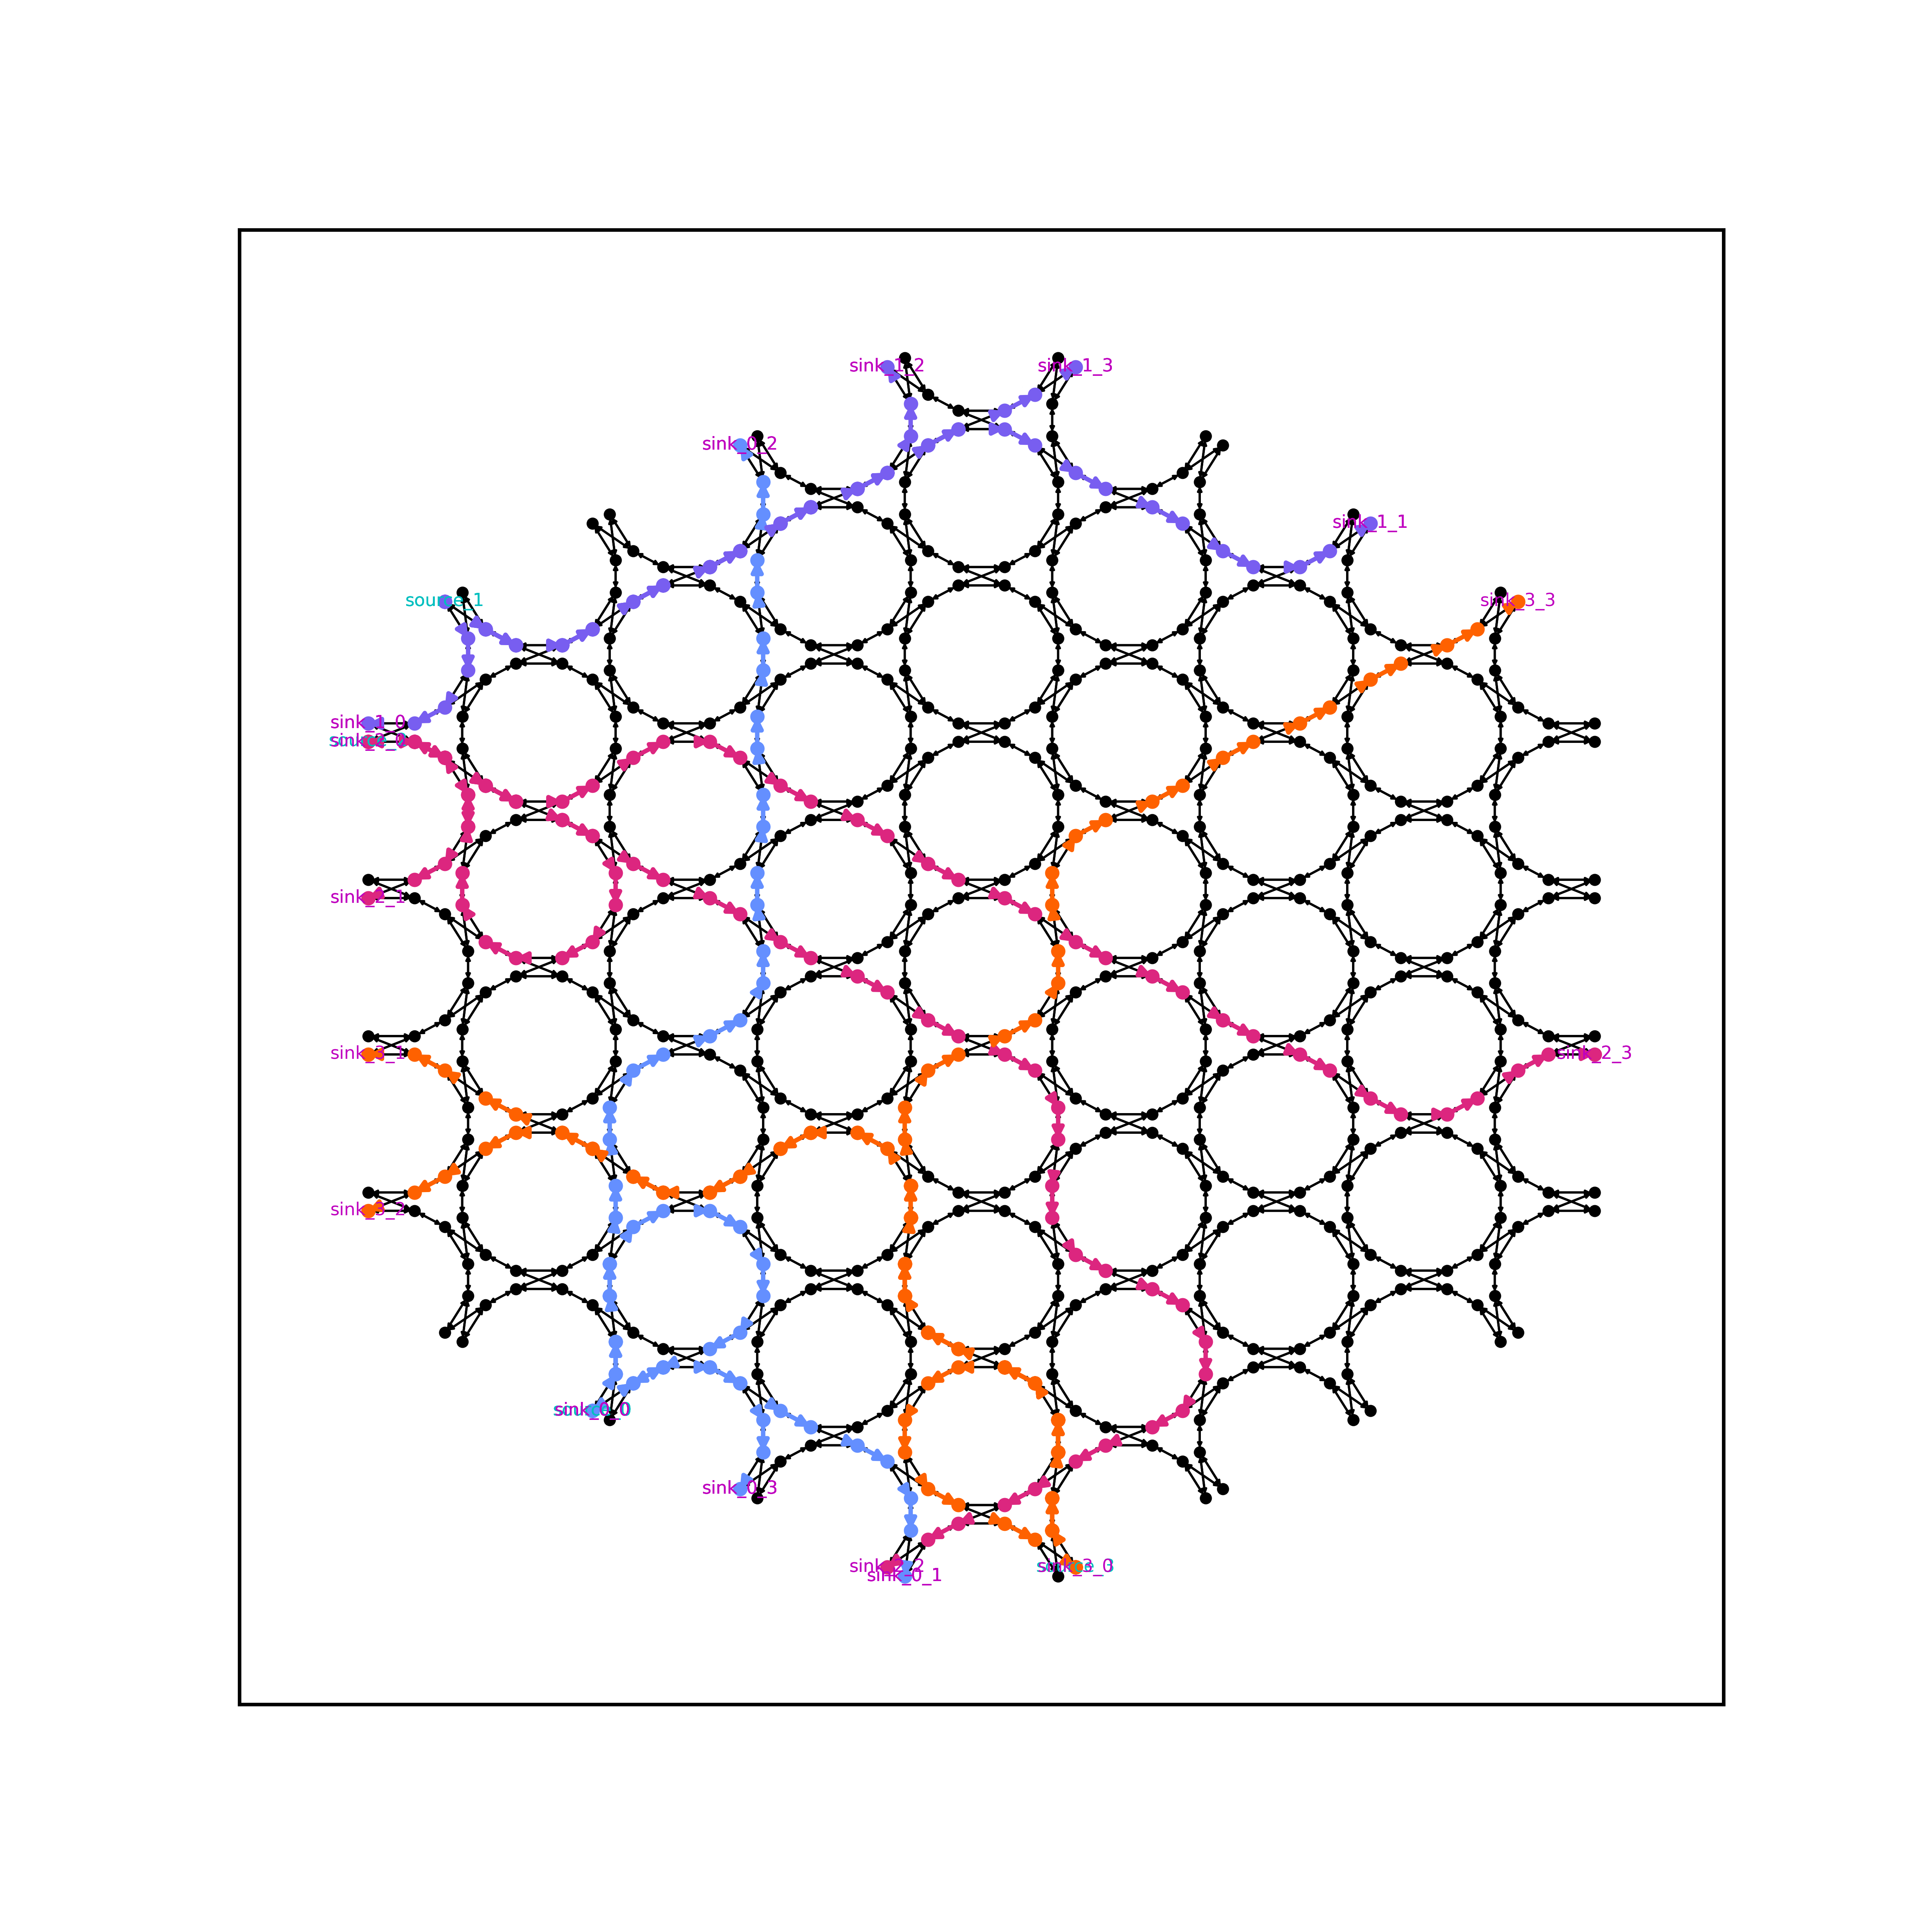
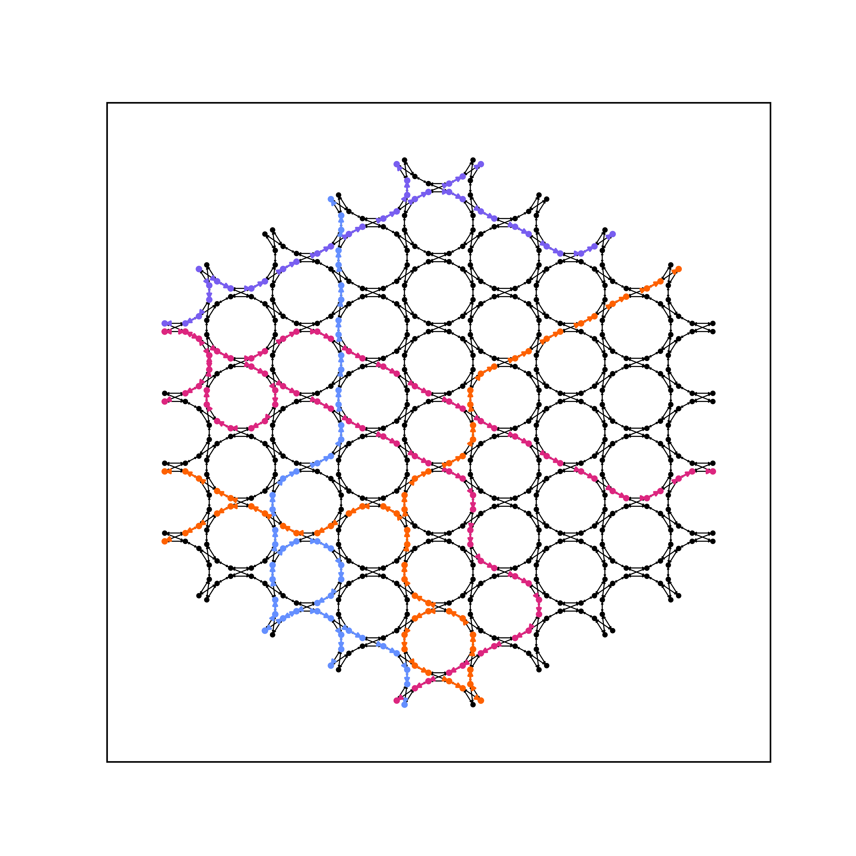

Slide 24
References

Slide 25
bibliography
[1] Bogaerts, Wim, et al. "Programmable photonic circuits." Nature 586.7828 (2020): 207-216.
[2] Zhuang, Leimeng, et al. "Programmable photonic signal processor chip for radiofrequency applications." Optica 2.10 (2015): 854-859.
[3] Pérez, Daniel, et al. "Multipurpose silicon photonics signal processor core." Nature communications 8.1 (2017): 636.
[4] Chen, Xiangfeng, et al. "Graph representations for programmable photonic circuits." Journal of Lightwave Technology 38.15 (2020): 4009-4018.
[5] López, Aitor, et al. "Auto-routing algorithm for field-programmable photonic gate arrays." Optics Express 28.1 (2020): 737-752.
[6] Kerchove, Ferre Vanden, et al. "Adapting Routing Algorithms to Programmable Photonic Circuits." 2022 European Conference on Optical Communication (ECOC). IEEE, 2022.
[7] Vansteenkiste, Elias, Karel Bruneel, and Dirk Stroobandt. "A connection-based router for FPGAs." 2013 International Conference on Field-Programmable Technology (FPT). IEEE, 2013.
[8] Vercruyce, Dries, Elias Vansteenkiste, and Dirk Stroobandt. "CRoute: a fast high-quality timing-driven connection- based FPGA router." 2019 IEEE 27th Annual International Symposium on Field-Programmable Custom Computing Machines (FCCM). IEEE, 2019.
[10] McMurchie, Larry, and Carl Ebeling. "Pathfinder: A negotiation-based performance-driven router for FPGAs." Proceedings of the 1995 ACM third international symposium on Field-programmable gate arrays. 1995.

Slide 26
Questions

Slide 27



Xiaoke Wang Master Student Department of electronics and information systems E xiaoke.wang@ugent.be T +32 456392882 www.ugent.be
Universiteit Gent @ugent
@ugent Ghent University

